Slide 1
Gencyber Grizzly Summer Institute
Day 2.4—Cryptanalysis and Keys

Slide 2
What’s this?
wklv lv pb vxshu vhfuhw phvvdjh!
Given this message encrypted with a Caesar Cipher, how might you decrypt it?

Slide 3
Deciphered
wklv lv pb vxshu vhfuhw phvvdjh!
Shift of 3
this is my super secret message!

Slide 4
Quality of a Cipher
A good cipher tries to make the ciphered text unrecognizable!
Many Ciphers only cover up some of the information

Slide 5
Cryptanalysis
The art (and science) of deciphering ciphers.
What might be a good way to decipher a Caesar cipher?

Slide 6
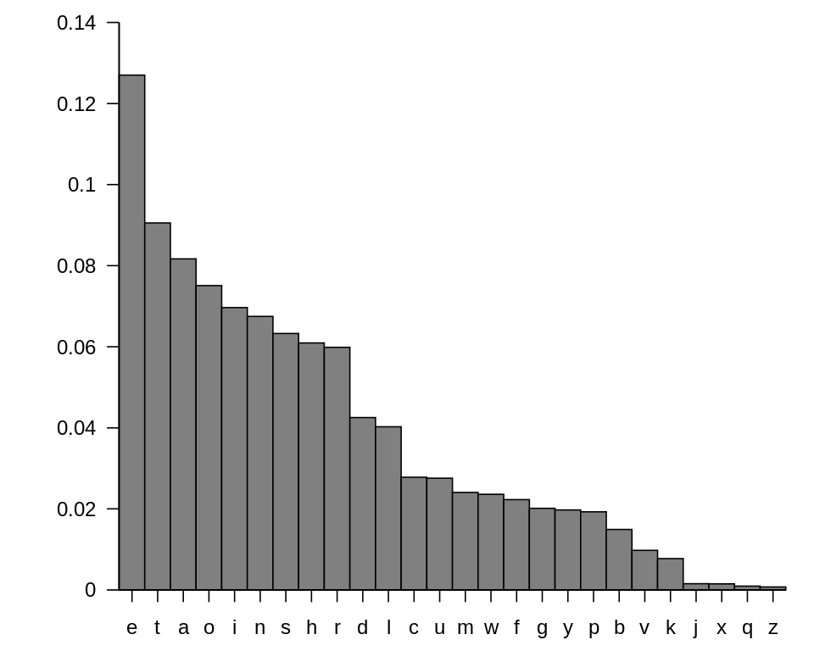
Letter Frequencies
Specifically for English
This Photo by Unknown Author is licensed under CC BY-SA

Slide 7
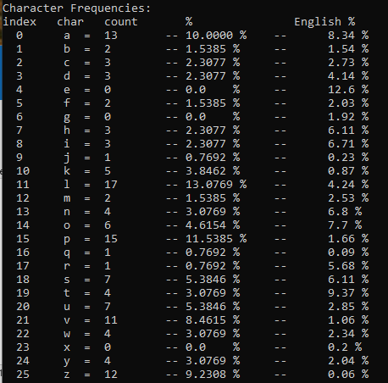
Letter Frequencies for ciphered_message1.txt

Slide 8
Decrypt the Cipher Game
Use Ciphor to decrypt the ciphered messages. Each Team gets 1 point for each correctly decrypted message.

Slide 9
The Caesar Cipher is Vulnerable to Letter Frequencies and Brute Force!
What might we change to the Caesar Cipher that would make it better?

Slide 10
Key Cipher
12
message
M | Y |  | M | E | S | S | A | G | E
C | A |  | T | C | A | T | C | A | T
O | Y |  | F | G | S | L | C | G | X
2
key
cipher
14

Slide 11
Key Cipher
Use ciphor to encrypt the plain_text1.txt message
Python ciphor.py –f plain_text1.txt –k <key> -e –o cipher.txt
Use the following keys:
Key = “b”
Key = “cat”
key “abcdef”
key “Super Fun Time”
key “Reckless Alpine Alpha Gets Frostbite”
Look at the stats of the cipher text each time
Can you find anything in the cipher texts that helps you decrypt it?
How about if the message is “aaaaaaaaaaaaaaaaaaaaaaaa””

Slide 12
Cycles in Key Ciphers
If the key is shorter than the message, then cycles develop!
a | a | a | a | a | a | a | a | a | a
C | A | T | C | A | T | C | A | T | C
C | A | T | C | A | T | C | A | T | C

Slide 13
Weaknesses in Key Ciphers
What might be some other weaknesses in Key Ciphers?

Slide 14
Weaknesses in Key Ciphers
Cycles (i.e. just multiple Caesar ciphers)
Distribution of keys!
What would you do to secure these risks? Try to come up with a brief plan.

Slide 15
Summary
A Caesar Cipher is a very flawed encryption
Simple analysis can defeat it quickly
A key cipher adds more protection
However, the length of the key can cause problems
Further, distribution of keys is also problematic.
What do you think would be the perfect key?

